Slide 1
Simulate the robot in Gazebo
Understand TFs
Design a custom robot with URDF
Simulate the robot in Gazebo

Slide 2
Simulate robot with Gazebo

Slide 3
Installing
First, make sure Gazebo is installed with sudo apt install ros-humble-gazebo* (don't forget the *)
Second, you might need to add this line at the end of your .bashrc (after the line to source ROS 2): source /usr/share/gazebo/setup.bash

Slide 4
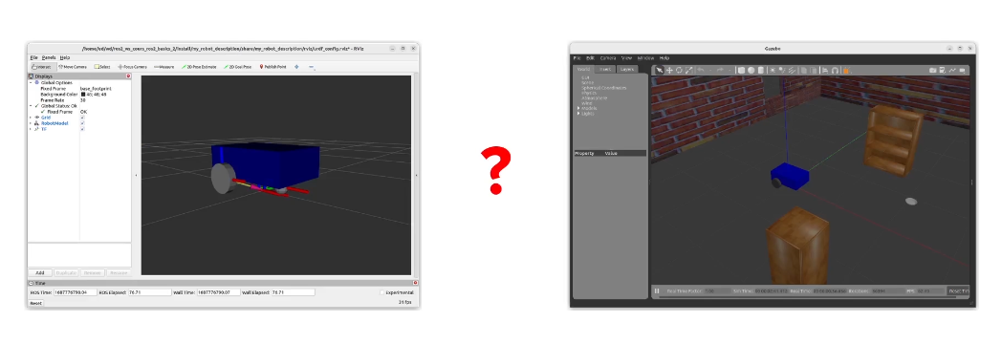
What is difference between RVIZ and GAZEBO?
Visualization, debug (not simulation)
Simulation (gravity, physics)

Slide 5
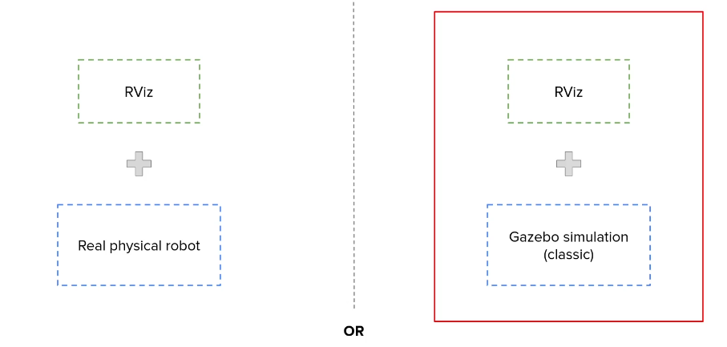
Introduction

Slide 6
Introduction
Understand how gazebo is integrated with ROS2
Adapt URDF for Gazebo
Add a Gazebo control plugin
Create a simulated world for the robot

Slide 7
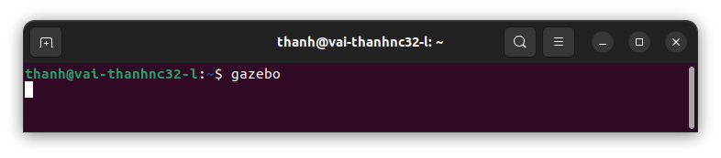
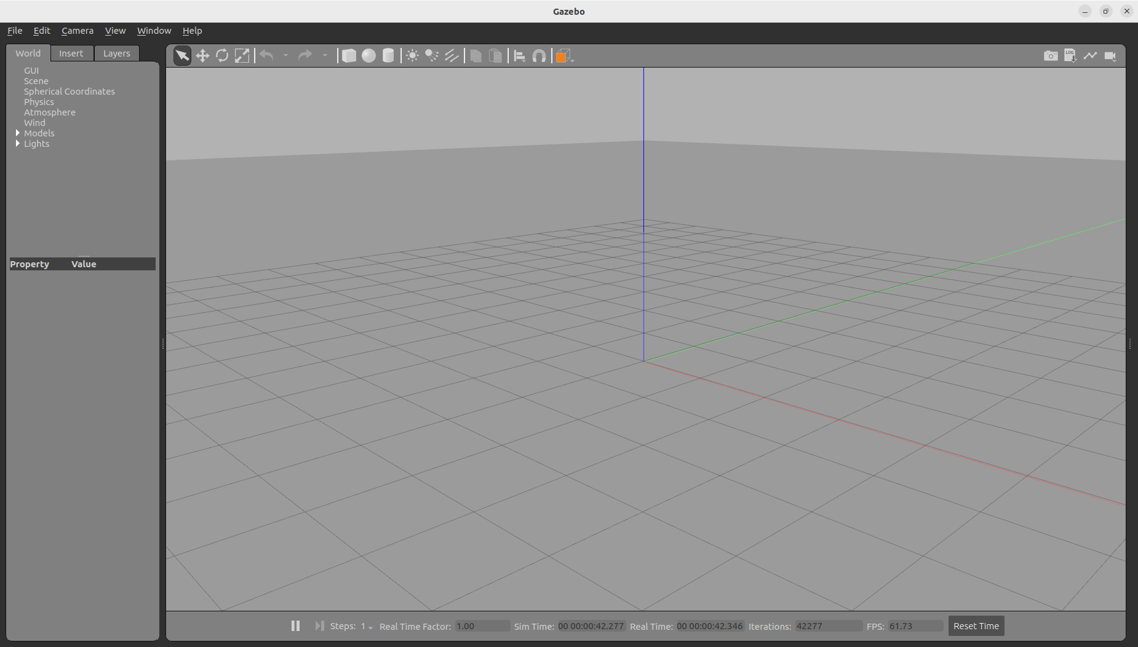
Run Gazebo
in terminal, run gazebo by
And waiting to gazebo start as below, and we can make some simple actions
https://gazebosim.org/docs/latest/tutorials/

Slide 8
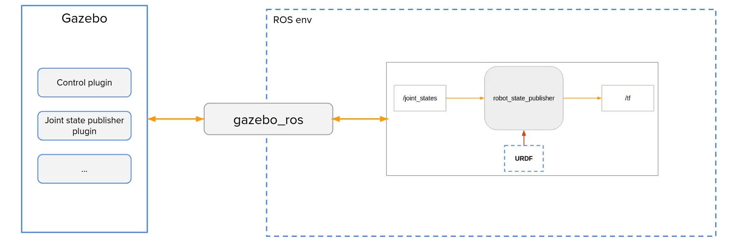
How Gazebo Works with ROS

Slide 9
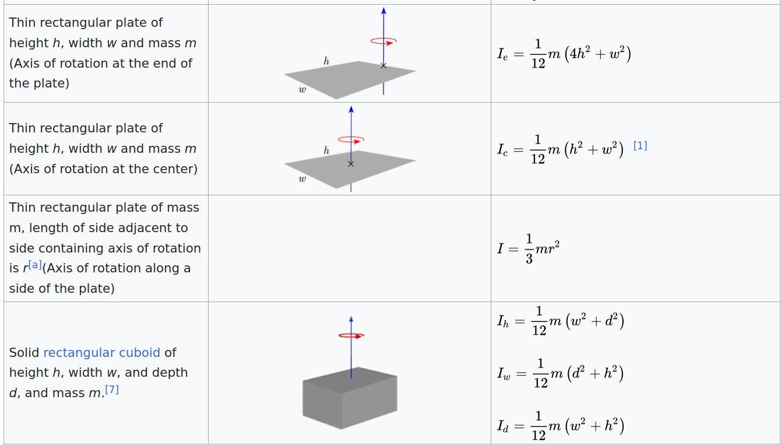
Add Inertia Tags in the URDF
y
z
x

Slide 10
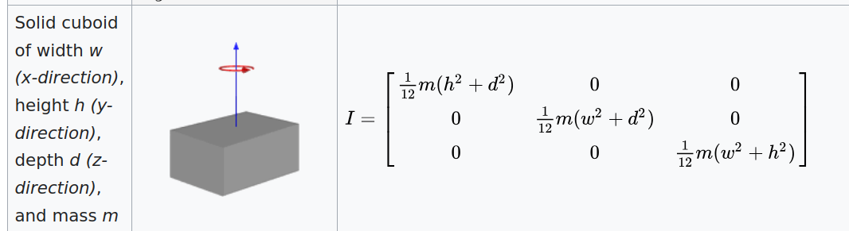
Add Inertia Tags in the URDF
Example for base_link
Inertia of solid box
https://en.wikipedia.org/wiki/List_of_moments_of_inertia#List_of_3D_inertia_tensors
y
z
x

Slide 11
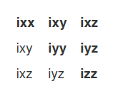
Add Inertia Tags in the URDF
The 3x3 rotational inertia matrix
https://wiki.ros.org/urdf/Tutorials/Adding%20Physical%20and%20Collision%20Properties%20to%20a%20URDF%20Model

Slide 12
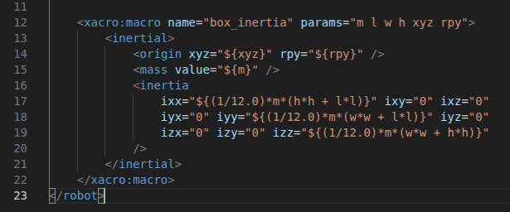
Add Inertia Tags in the URDF
Configure the inertia of body box in common_properties.xacro

Slide 13
Add Inertia Tags in the URDF
Applying inertia for all links as sample sources

Slide 14
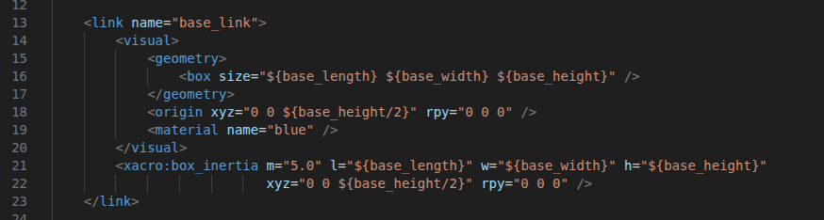
Add Inertia Tags in the URDF
Update inertia for base_link in mobile_base.xacro
unit: kg, m

Slide 15
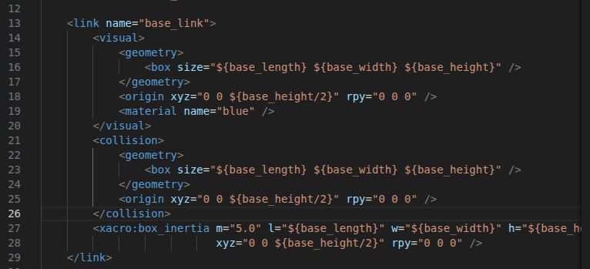
Add Collision Tags in the URDF
Add Collision for base_link in mobile_base.xacro
After </visual>, before xacro:box_inertia

Slide 16
Add Collision Tags in the URDF
Applying Collision for all links as sample sources

Slide 17
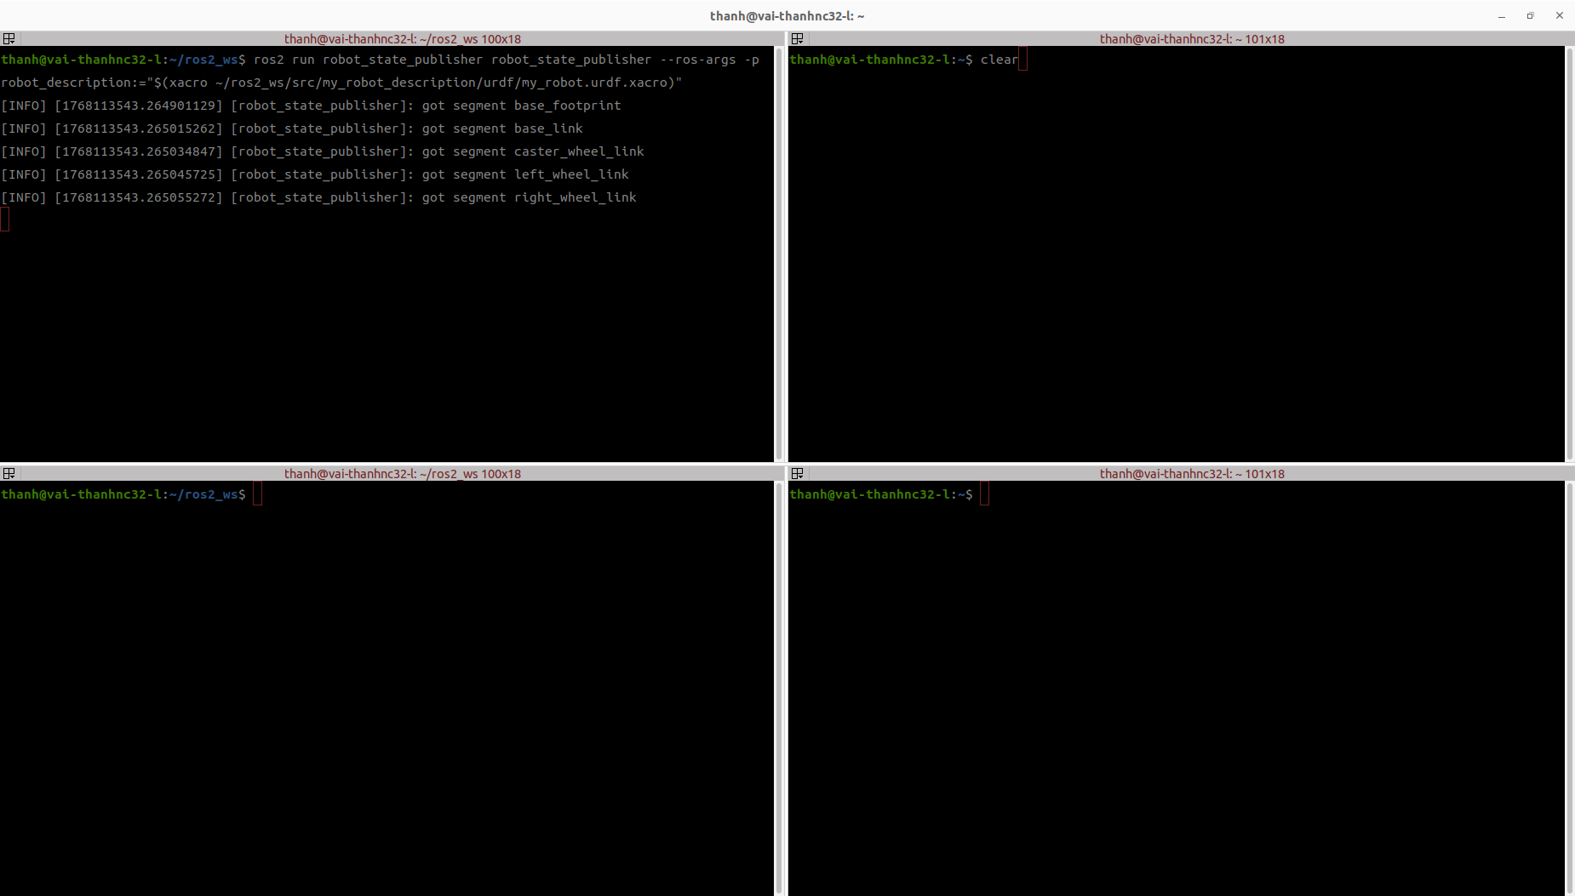
Spawn the Robot in Gazebo
Update Inertia and Collision tags for all links as urdf solution activity inertia
Run the my_robot.urdf.xacro in ~/ros2_ws/src/my_robot_description/urdf/my_robot.urdf.xacro
ros2 run robot_state_publisher robot_state_publisher --ros-args -p robot_description:="$(xacro ~/ros2_ws/src/my_robot_description/urdf/my_robot.urdf.xacro)"

Slide 18
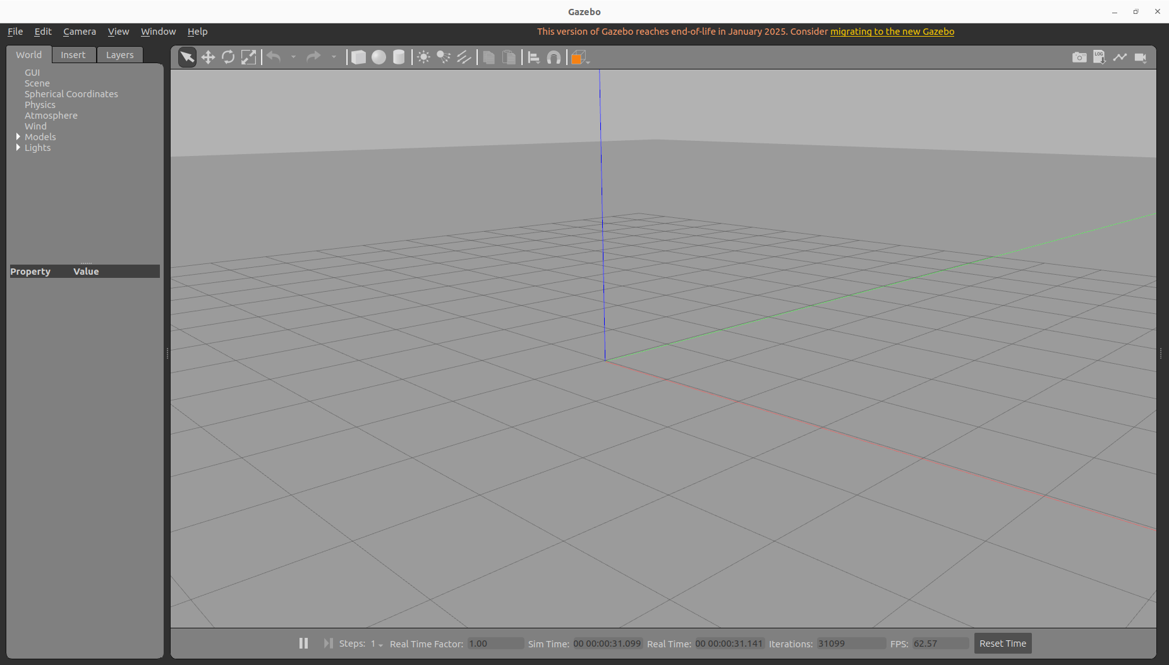
Spawn the Robot in Gazebo
Gazebo starts as

Slide 19
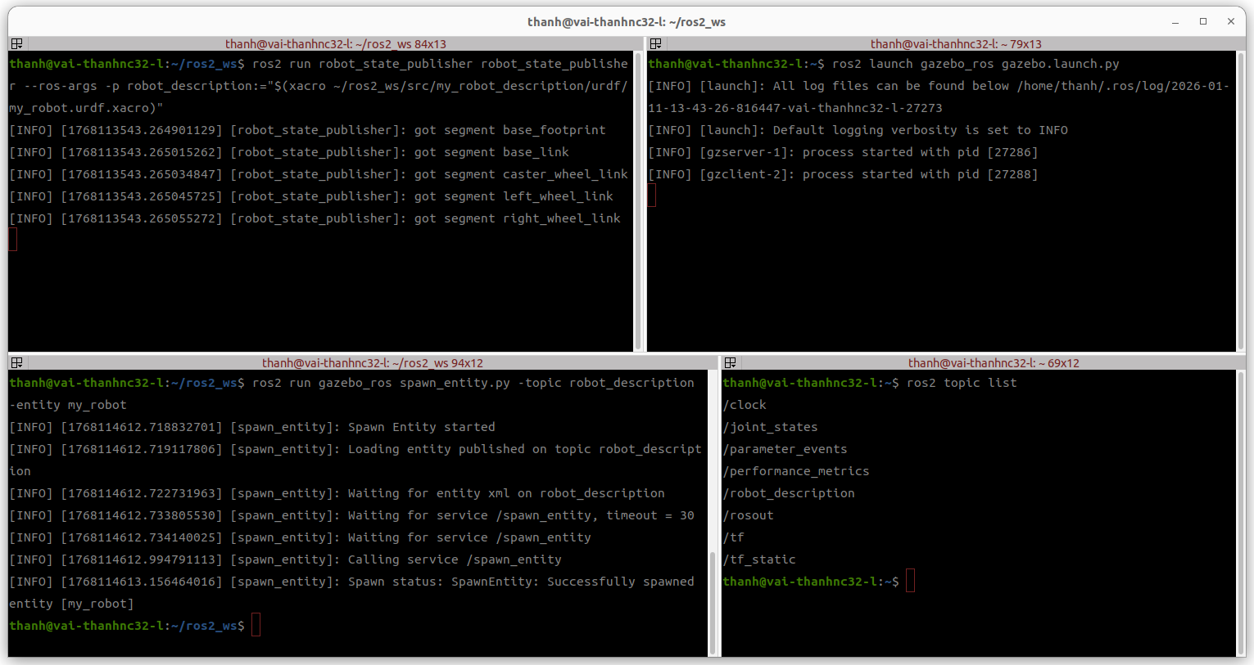
Spawn the Robot in Gazebo
Spawn the robot in Gazebo
ros2 run gazebo_ros spawn_entity.py -topic robot_description -entity my_robot

Slide 20
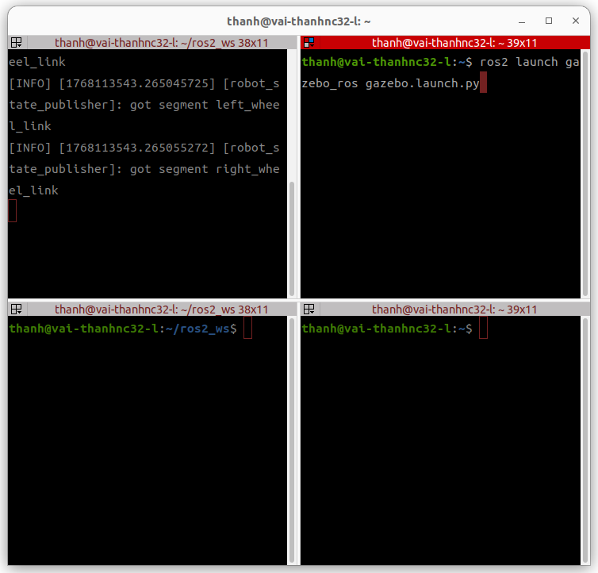
Spawn the Robot in Gazebo
Start Gazebo from launch file

Slide 21
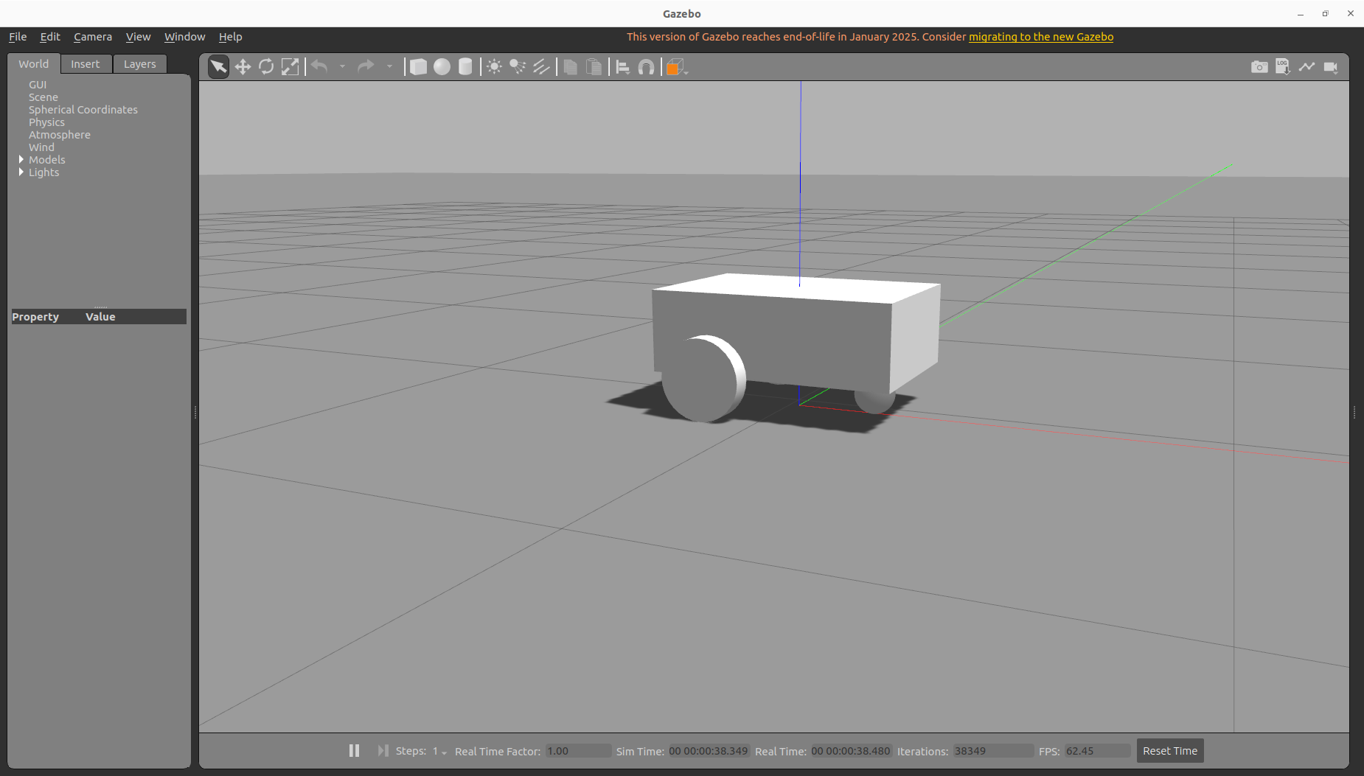
Spawn the Robot in Gazebo

Slide 22
Spawn the Robot in Gazebo
Exercises: changing the collision and inertia to check the spawn of robot in Gazebo
bài tập: thực hiện các thay đổi để tìm hiểu về ảnh hưởng của collision và inertia lên robot

Slide 23
Launch File to Start Robot in Gazebo
- Create a new package “my_robot_bringup”
- Create and install a “launch” folder
- Add a new launch file “my_robot_gazebo.launch.xml”
- In the launch file, start:
- Robot state publisher node
- Gazebo launch file (using <include file=”” /> tag)
- Spawn_entity.py node
- Rviz2 with config

Slide 24
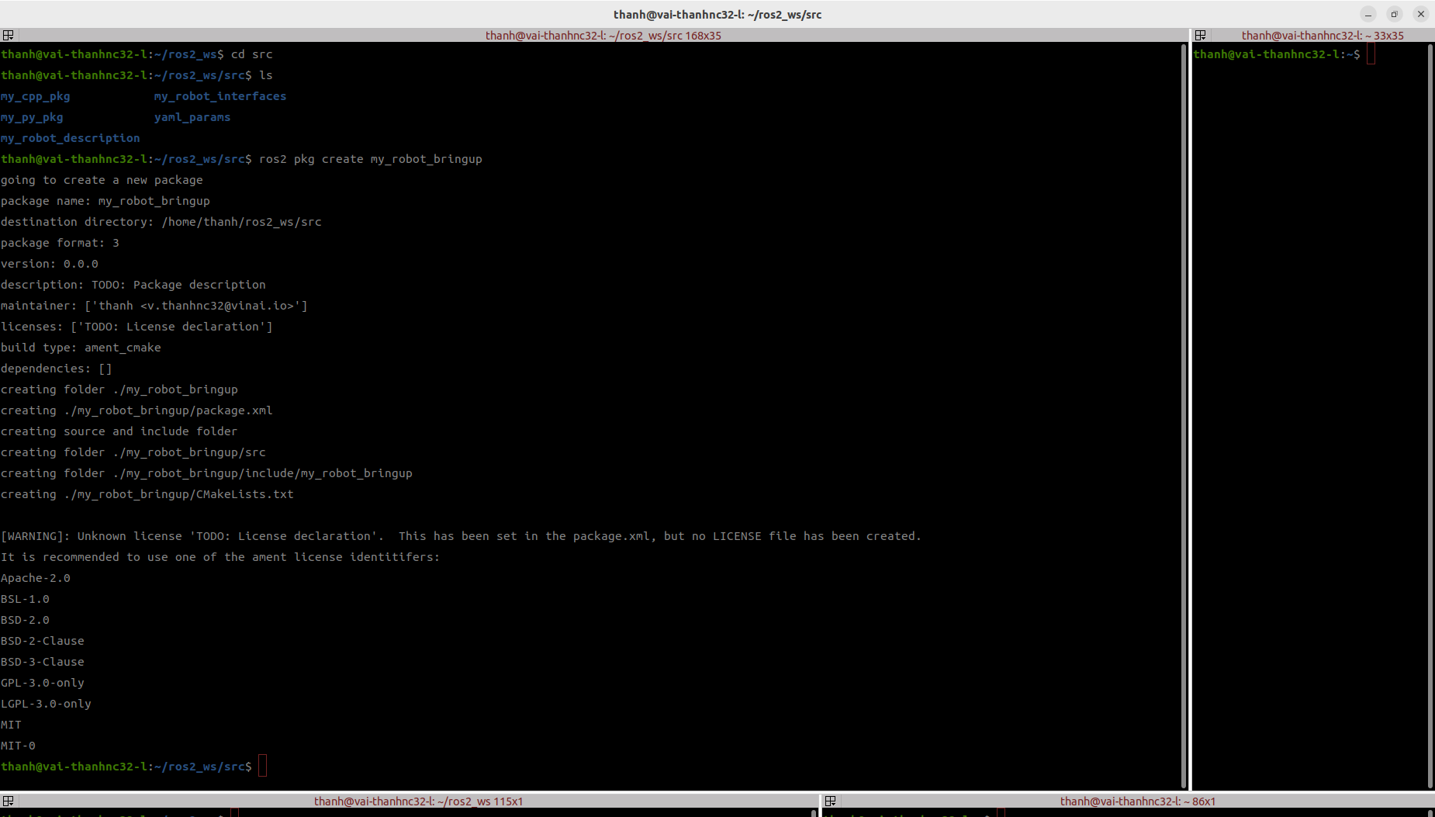
Launch File to Start Robot in Gazebo
- Create a new package “my_robot_bringup” as C++ default package

Slide 25
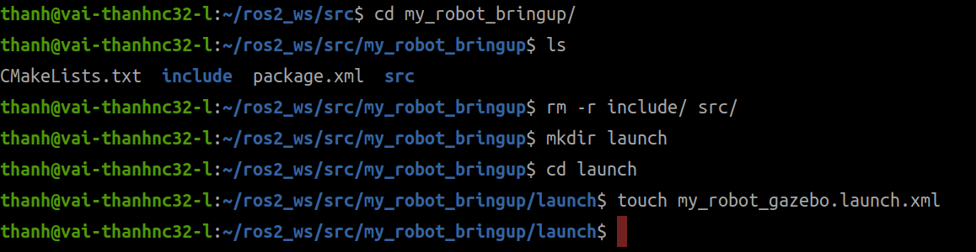
Launch File to Start Robot in Gazebo
- Re-structiching my_robot_bringup package by removing include/ and src/
- Create my_robot_gazebo.launch.xml launch file in launch/

Slide 26
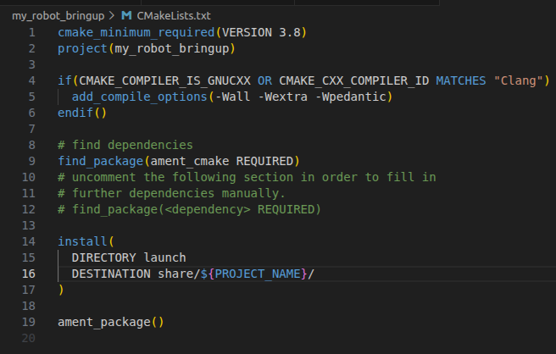
Launch File to Start Robot in Gazebo
- Modify CMakelists.txt

Slide 27
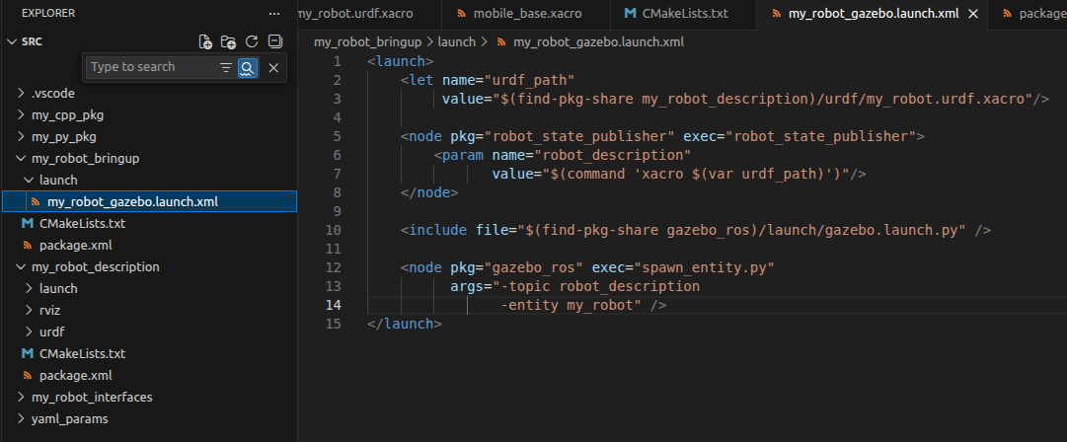
Launch File to Start Robot in Gazebo
- Create launch file my_robot_gazebo.launch.xml

Slide 28
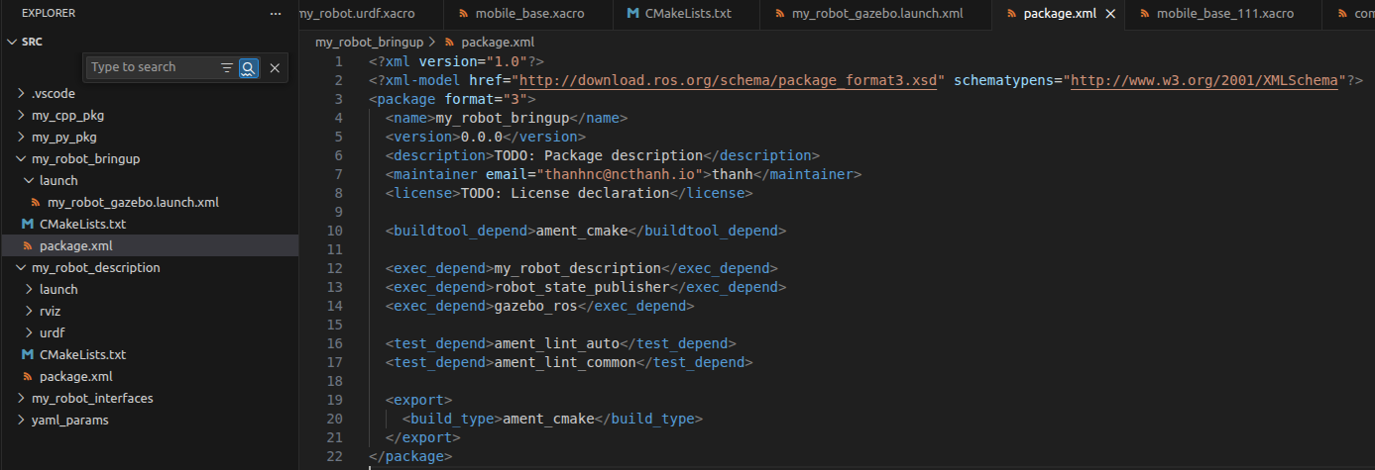
Launch File to Start Robot in Gazebo
- Adding 3 executive depends to package.xml:
<exec_depend>my_robot_description</exec_depend>
<exec_depend>robot_state_publisher</exec_depend>
<exec_depend>gazebo_ros</exec_depend>

Slide 29
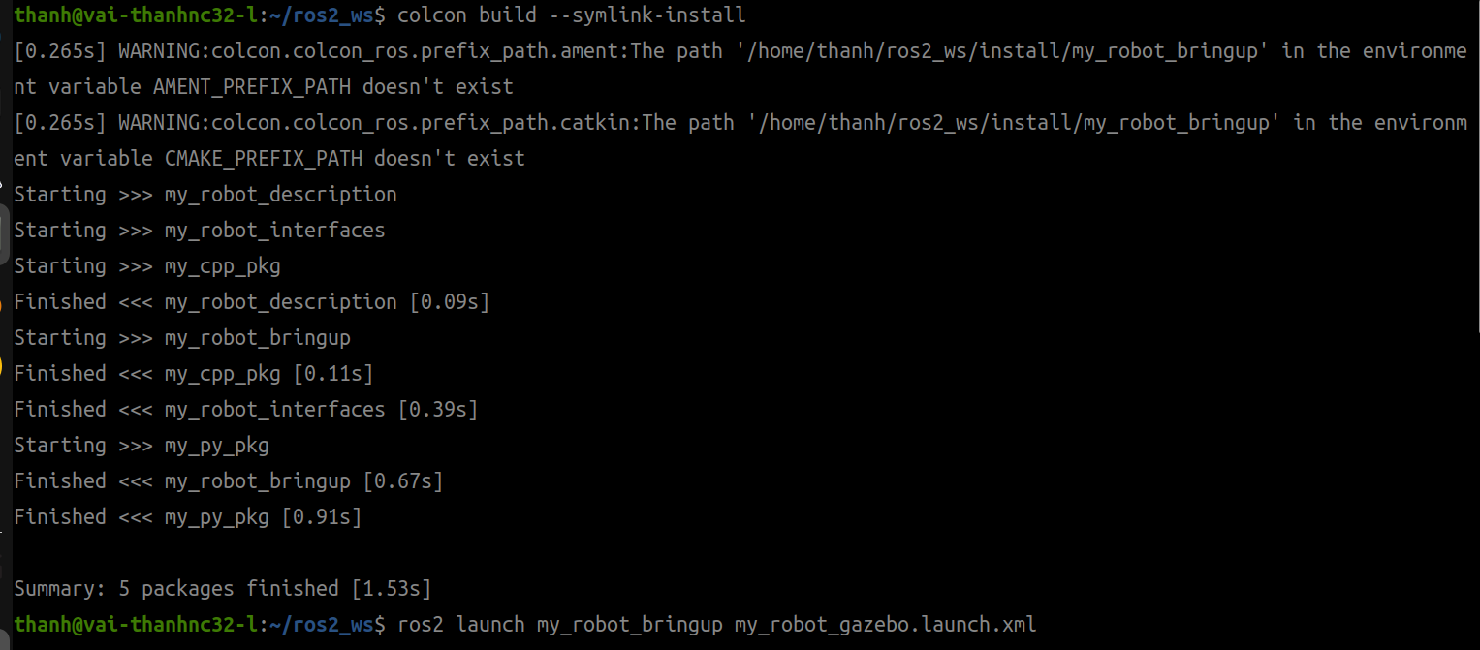
Launch File to Start Robot in Gazebo
- Build and launch

Slide 30
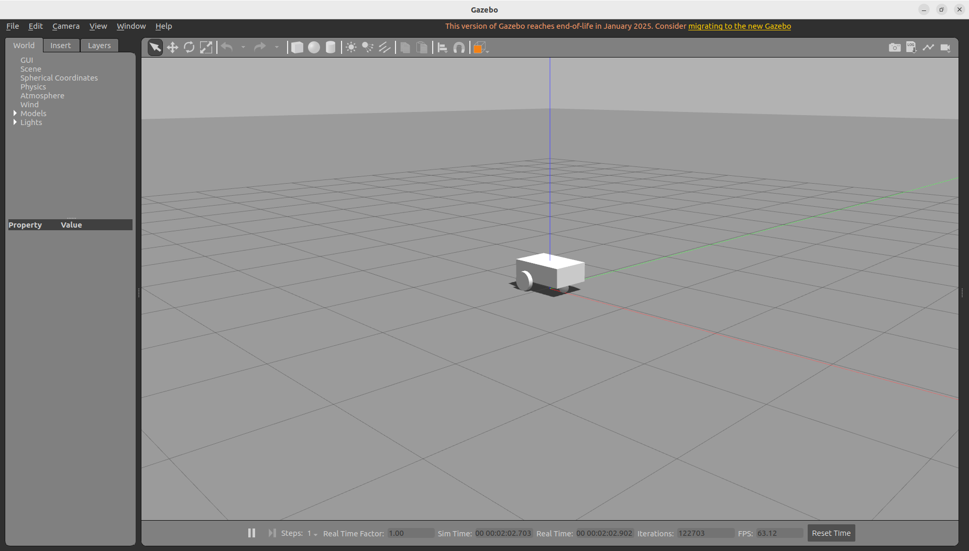
Launch File to Start Robot in Gazebo
- Build and launch

Slide 31
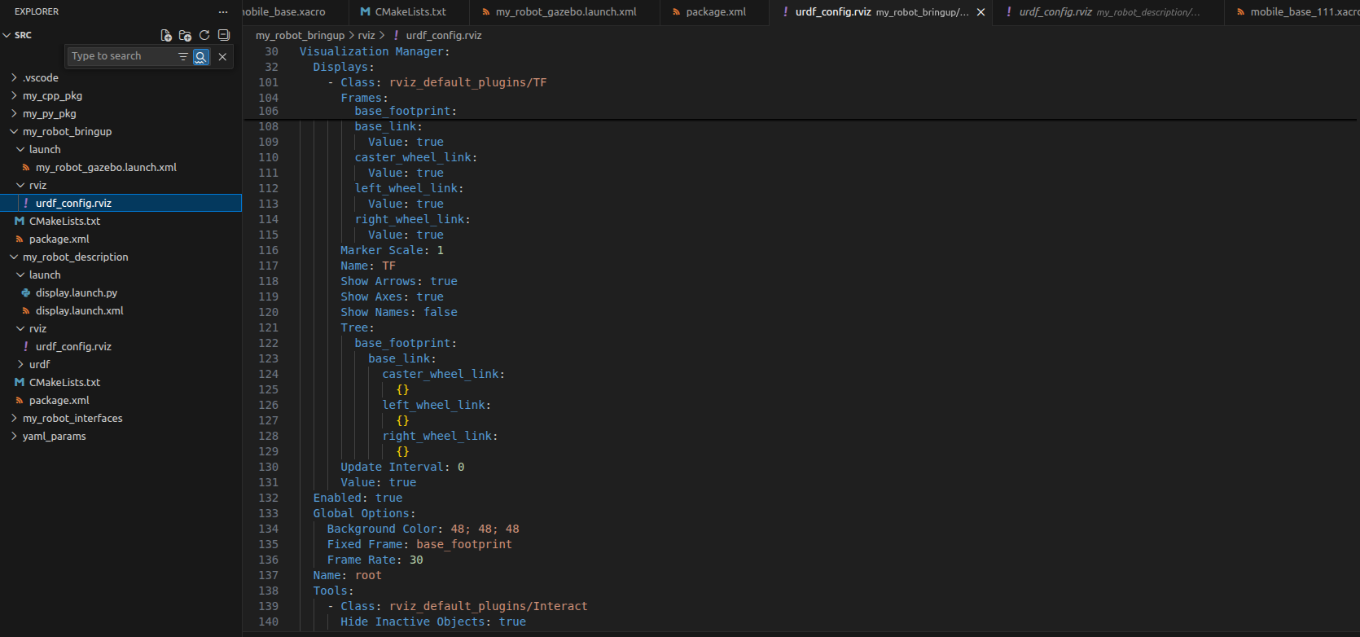
Launch File to Start Robot in Gazebo
- Creating the /my_robot_bringup/rviz/urdf_config.rviz by copying from my_robot_description/rviz/urdf_config.rviz

Slide 32
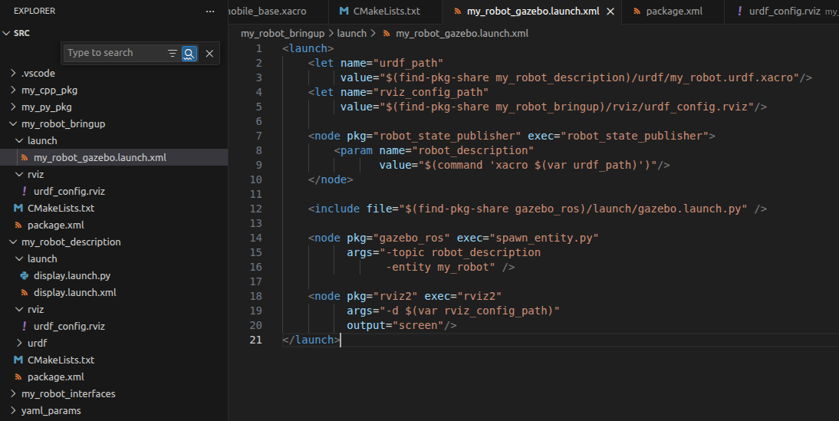
Launch File to Start Robot in Gazebo
- Adding rviz config path and rviz to launch file
<let name="rviz_config_path"
value="$(find-pkg-share my_robot_bringup)/rviz/urdf_config.rviz"/>
<node pkg="rviz2" exec="rviz2"
args="-d $(var rviz_config_path)"
output="screen"/>

Slide 33
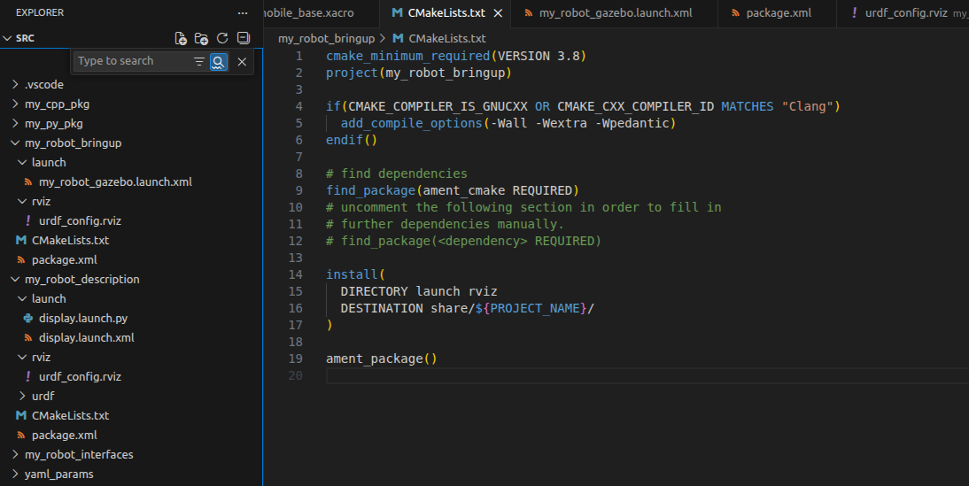
Launch File to Start Robot in Gazebo
- Adding rviz to install directory in CMakelists.txt

Slide 34
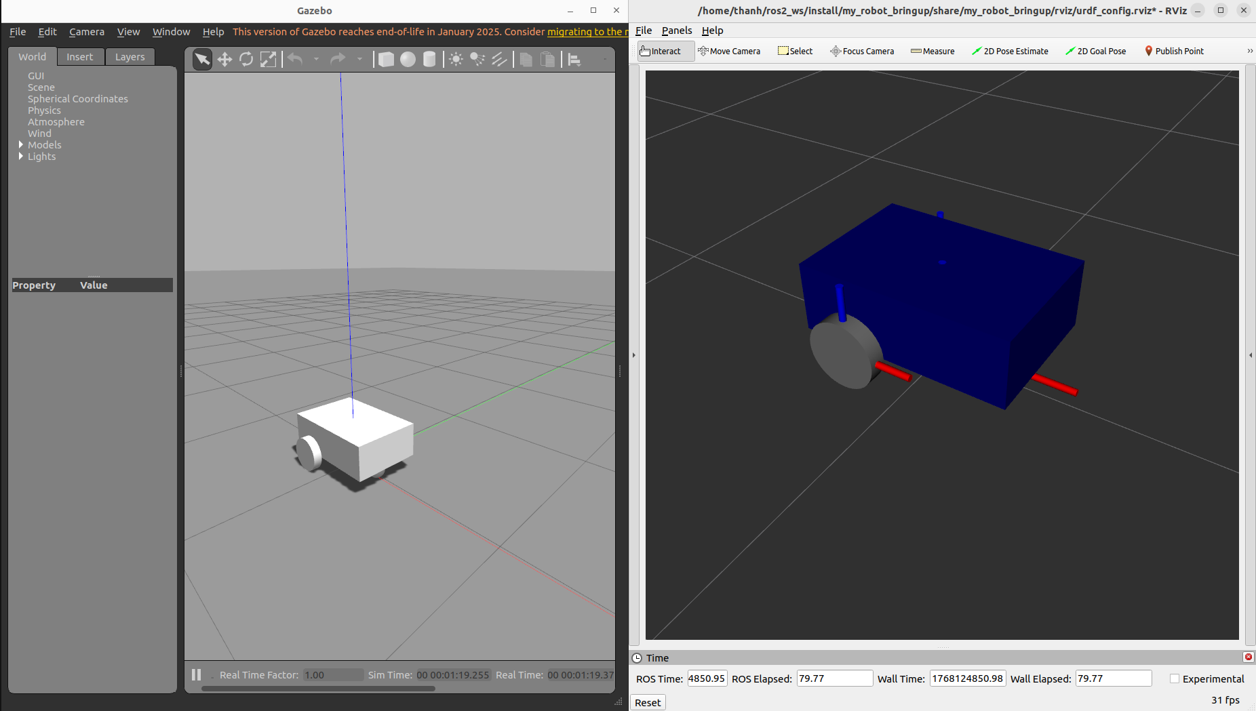
Launch File to Start Robot in Gazebo
- Build again: colcon build --symlink-install
- Re-launch: ros2 launch my_robot_bringup my_robot_gazebo.launch.xml

Slide 35
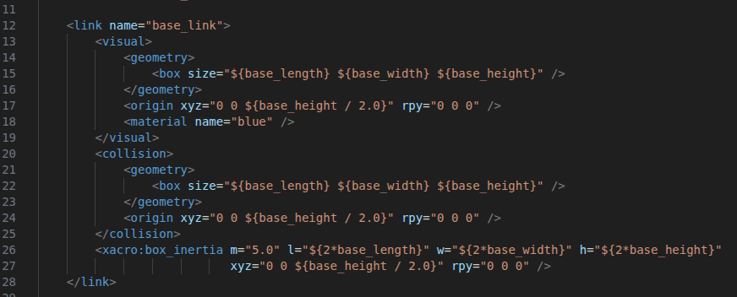
Fixing the Inertia Values
- Some initial values we set for robot is not as similar as real robot, so the robot behavior is weird, is not real.
Initial configuration for base_link’s inertia

Slide 36
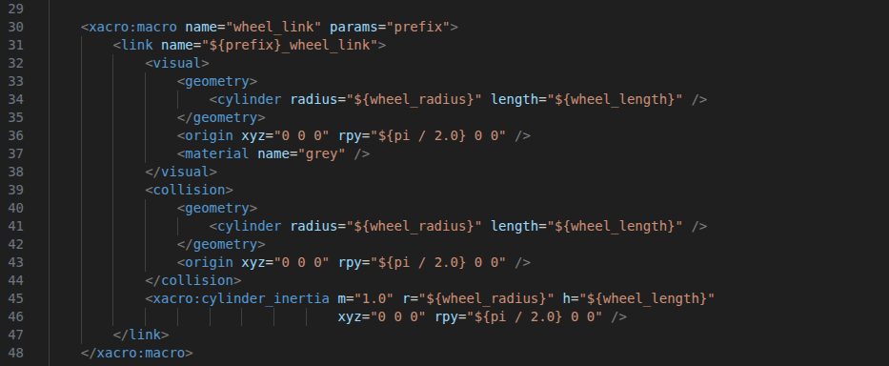
Fixing the Inertia Values
- Some initial values we set for robot is not as similar as real robot, so the robot behavior is weird, is not real.
Initial configuration for wheel_link’s inertia

Slide 37
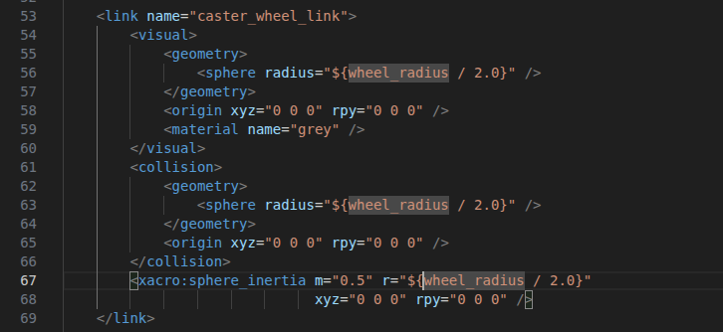
Fixing the Inertia Values
- Some initial values we set for robot is not as similar as real robot, so the robot behavior is weird, is not real.
Initial configuration for caster_wheel_link’s inertia

Slide 38
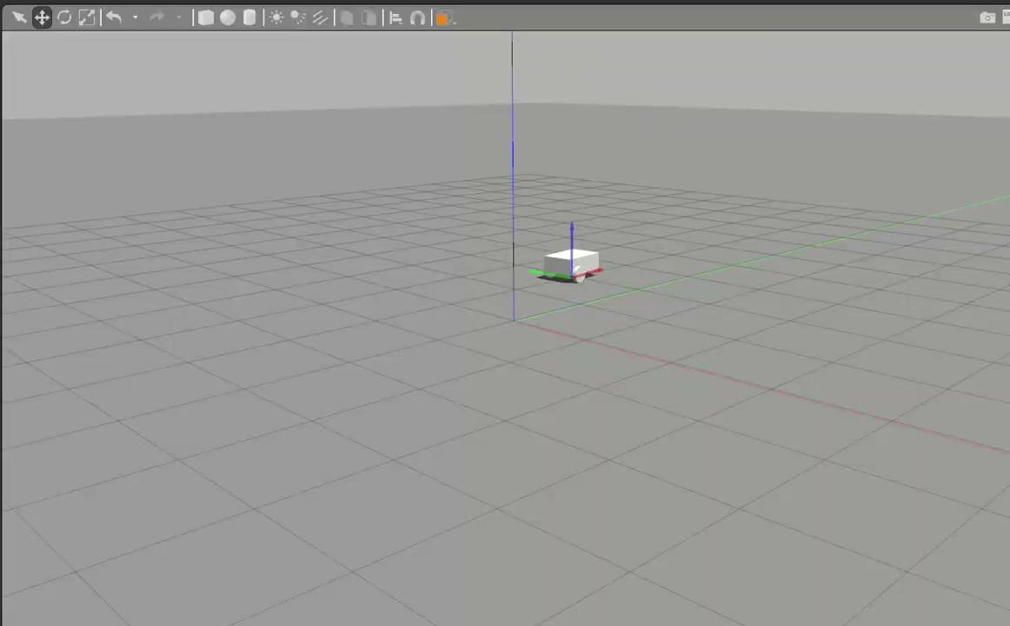
Fixing the Inertia Values
- some actions on Gazebo

Slide 39
Fixing the Inertia Values
- Some initial values we set for robot is not as similar as real robot, so the robot behavior is weird, is not real.
Modified configuration for base_link’s inertia

Slide 40
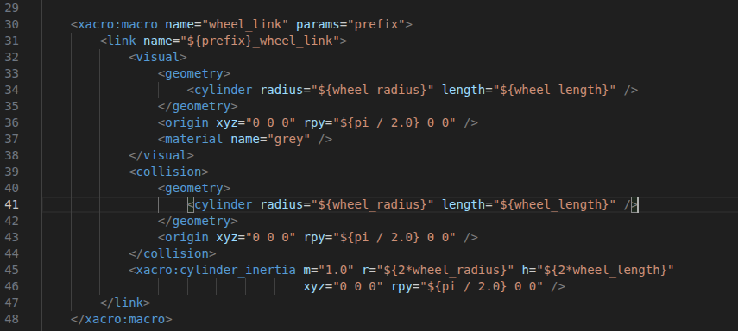
Fixing the Inertia Values
- Some initial values we set for robot is not as similar as real robot, so the robot behavior is weird, is not real.
Modified configuration for wheel_link’s inertia

Slide 41
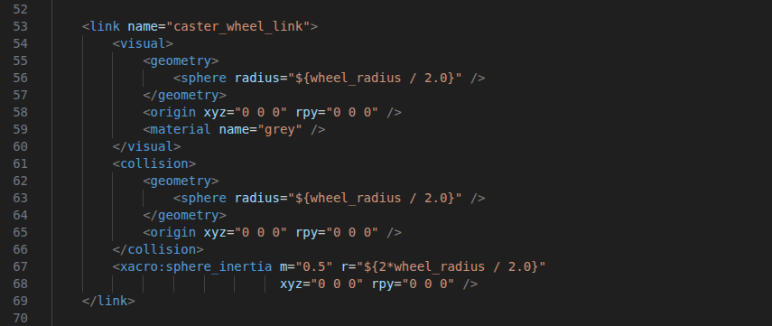
Fixing the Inertia Values
- Some initial values we set for robot is not as similar as real robot, so the robot behavior is weird, is not real.
Modified configuration for caster_wheel_link’s inertia

Slide 42

Fixing the Inertia Values
- some actions on Gazebo after modified

Slide 43
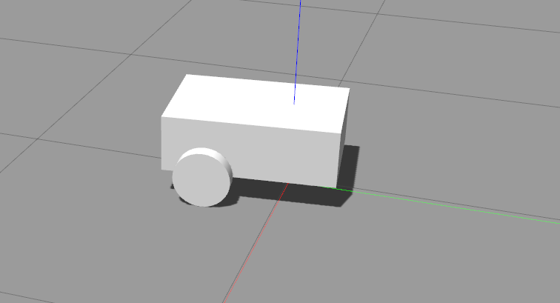
Fixing the Colors with Gazebo Material
The color is all grey now, and we will make the robot is colorful

Slide 44
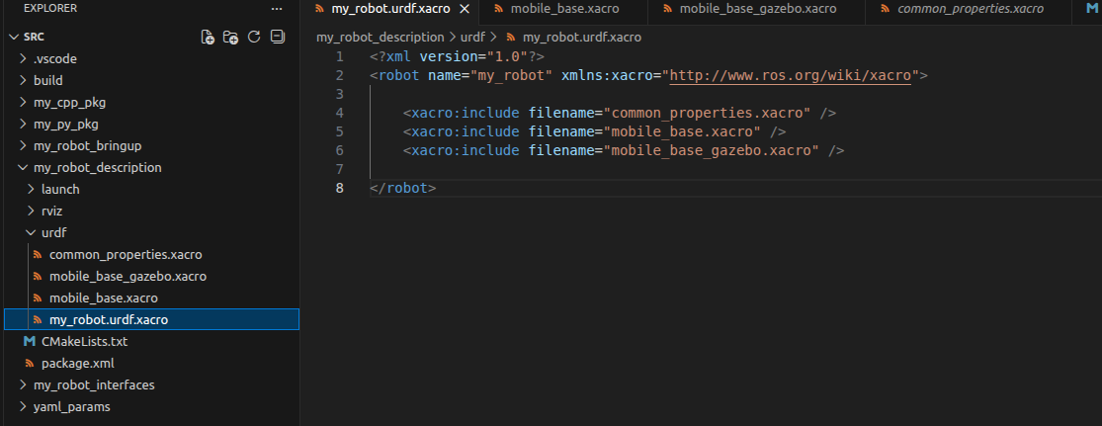
Fixing the Colors with Gazebo Material
Cerate mobile_base_gazebo.xacro Gazebo xacro and include into my_robot.urdf.xacro

Slide 45
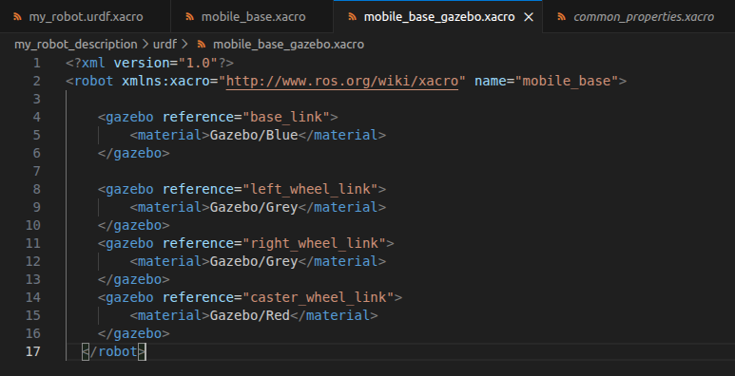
Fixing the Colors with Gazebo Material
mobile_base_gazebo.xacro is

Slide 46
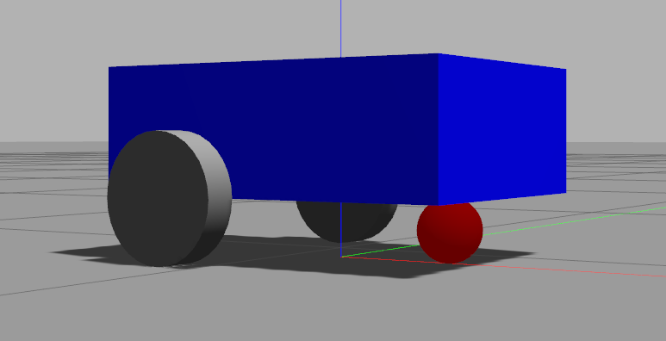
Fixing the Colors with Gazebo Material
The colors of robot body:

Slide 47
Add a Gazebo Plugin to Control the Robot
Gazebo plugins give your URDF models greater functionality and can tie in ROS messages and service calls for sensor output and motor input
go to documentation https://classic.gazebosim.org/tutorials?tut=ros_gzplugins
go to github gazebo ros pkgs https://github.com/ros-simulation/gazebo_ros_pkgs
Apply to control two wheels of the robot

Slide 48
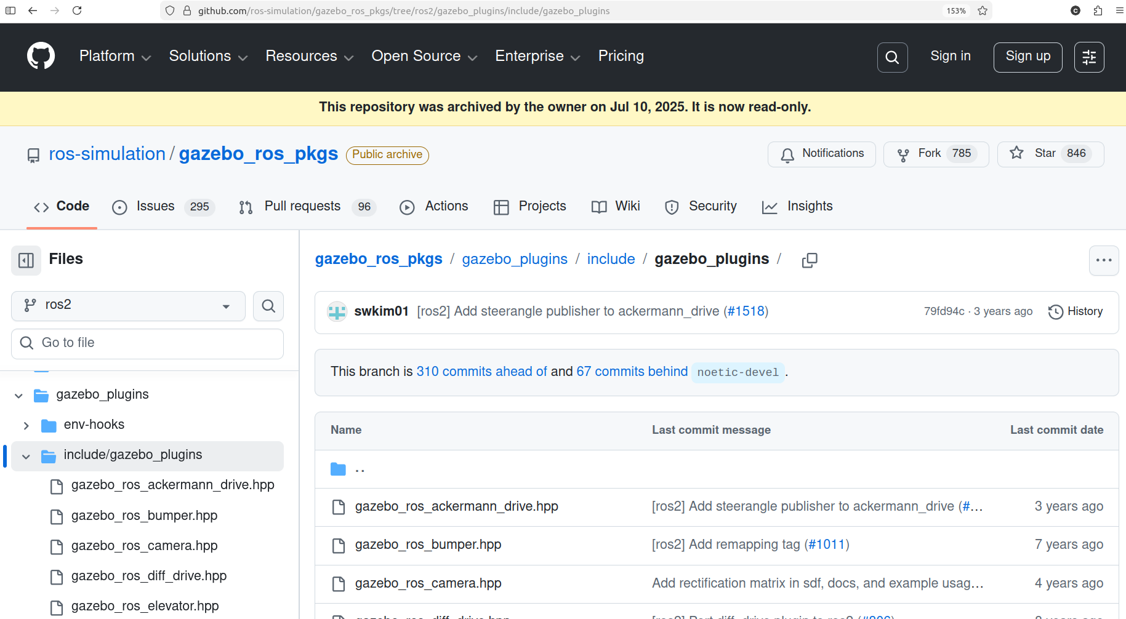
Add a Gazebo Plugin to Control the Robot
Select /gazebo_plugins/include/gazebo_plugins/ in branch ros2

Slide 49
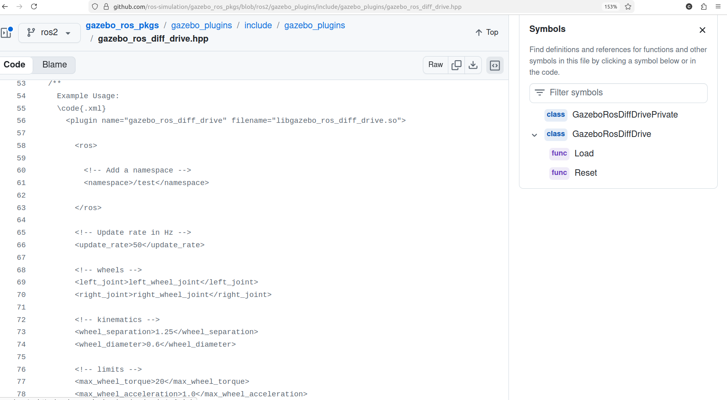
Add a Gazebo Plugin to Control the Robot
Example for drive plugin

Slide 50
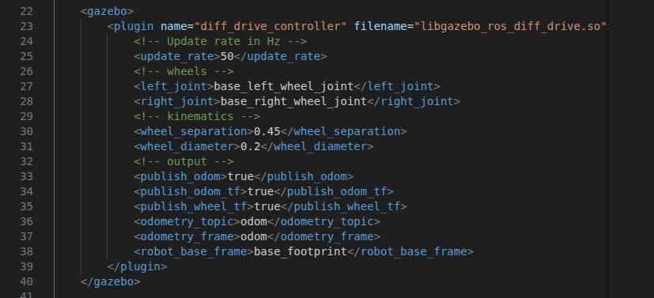
Add a Gazebo Plugin to Control the Robot
Add gazebo plugins into mobile_base_gazebo.xacro to control the two wheels

Slide 51
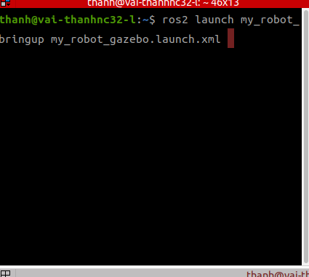
Add a Gazebo Plugin to Control the Robot
build the packages again: colcon build –symlink-install
launch my_robot_gazebo.launch.xml

Slide 52
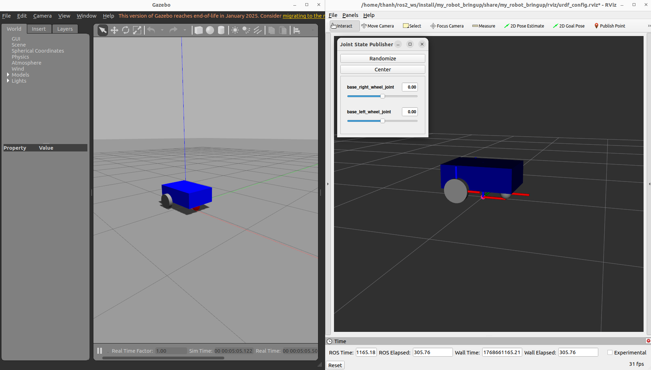
Add a Gazebo Plugin to Control the Robot
the rviz and gazebo are launched

Slide 53
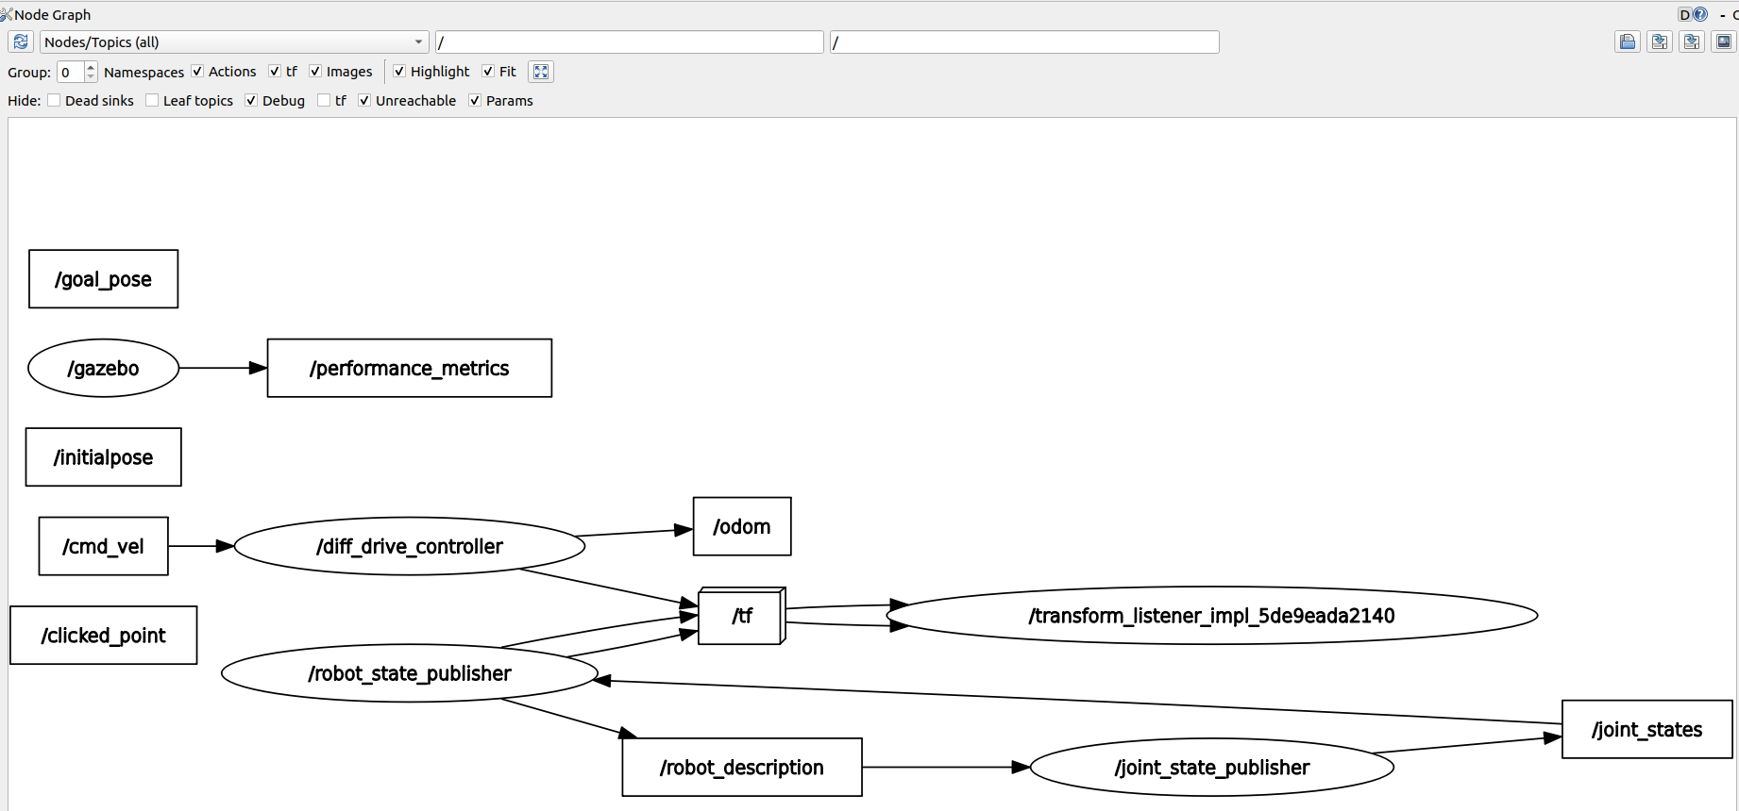
Add a Gazebo Plugin to Control the Robot
show node graph by rqt_graph

Slide 54
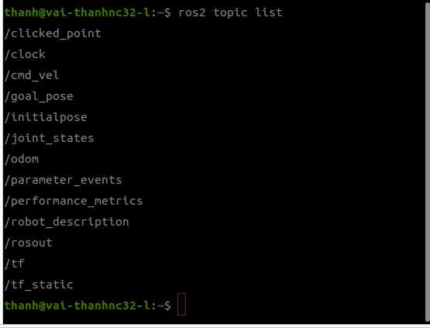
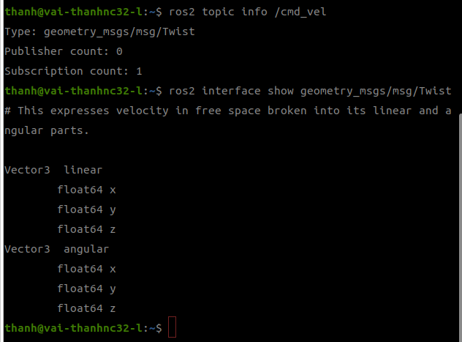
Add a Gazebo Plugin to Control the Robot
build the packages again: colcon build –symlink-install
launch my_robot_gazebo.launch.xml,

Slide 55
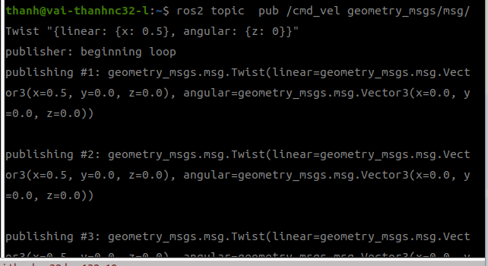
Add a Gazebo Plugin to Control the Robot
The robot will be controlled to move along linear x-direction and rotate around angular z-axis
The cmd_vel is set by ros2 pub

Slide 56
Add a Gazebo Plugin to Control the Robot
The results on gazebo and rviz

Slide 57
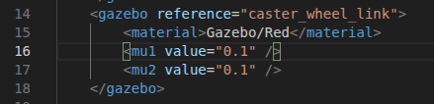
Add a Gazebo Plugin to Control the Robot
To control the robot smoother, we set the friction for caster_wheel in mobile_base_gazebo.xacro
Save and start launching again

Slide 58
Add a Gazebo Plugin to Control the Robot
The results on gazebo and rviz are smoother

Slide 59
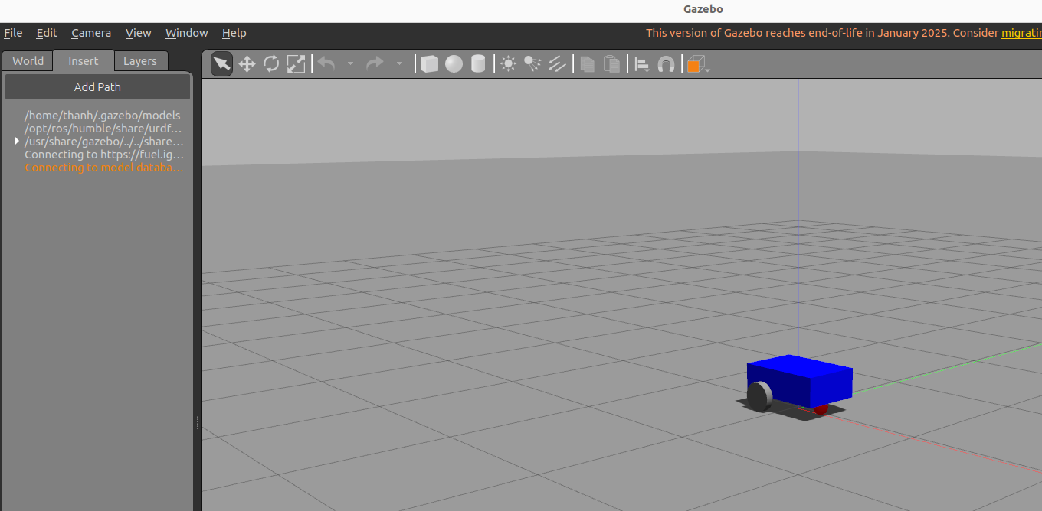
Create a World in Gazebo
launching the my_robot_gazebo.launch.xml
Click insert tab and wait the connecting with library

Slide 60
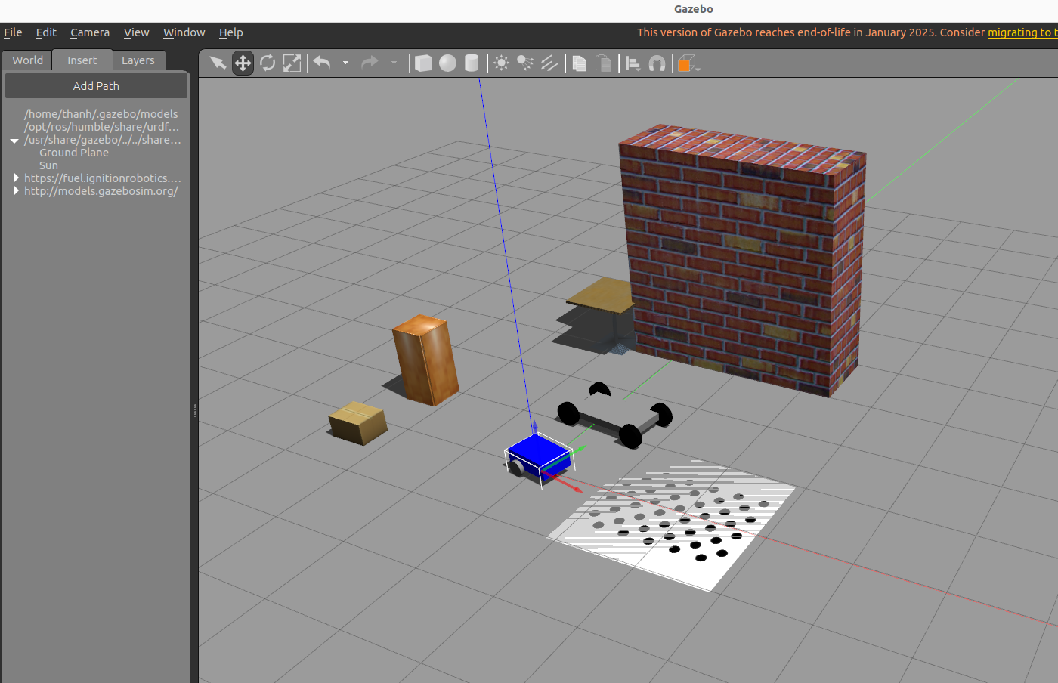
Create a World in Gazebo
inserting some of objects

Slide 61
Create a World in Gazebo
Go to edit tab, and select Building Editor or using Ctrl B, save the world

Slide 62
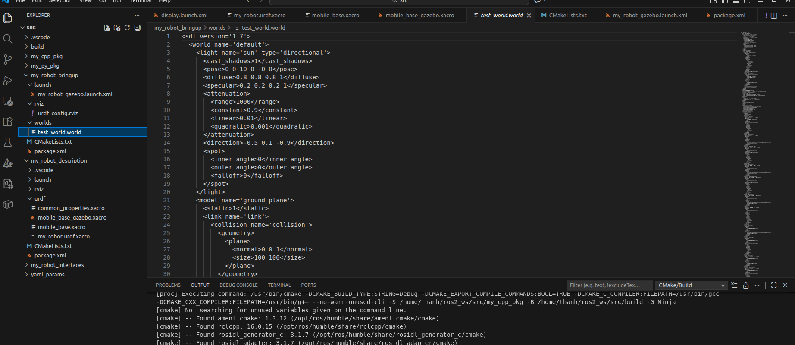
Launch the Robot in the World
build a the world for robot
remove/delete the robot to save the world only in my_robot_bringup/worlds/test_world
The my_robot_description and my_robot_bringup are as below, source is here sample codes

Slide 63

Launch the Robot in the World
add worlds to the CmakeLists.txt install

Slide 64

Launch the Robot in the World
add worlds to the CmakeLists.txt install

Slide 65
Launch the Robot in the World
To launch the robot in the world
run colcon build –symlink-install
source install/setup.bash
launching: ros2 launch my_robot_bringup my_robot_gazebo.launch.xml
If connot show the world in Gazebo
You must rm -r install/ log/ build/ and rebuild by colcon build

Slide 66

Launch the Robot in the World
results for test_world.world

Slide 67

Launch the Robot in the World
results for my_world.world:
change the world to my_world.world in launch file
rebuild: colcon build
launch on gazebo by ros2: ros2 launch my_robot_bringup my_robot_gazebo.launch.xml

Slide 68

Launch the Robot in the World
results for my_world.world:

Slide 69
Add a Camera Sensor in Gazebo
add the camera to the URDF
Configure a Gazebo plugin

Slide 70

Add a Camera to the URDF
Create new xacro file in /my_robot_description/urdf folder camera.xacro
configure camera as a box with geometry, material, collision, inertia

Slide 71

Add a Camera to the URDF
Add camera.xacro to my_robot.urdf.xacro

Slide 72

Add a Camera to the URDF
colcon build
ros2 launch my_robot_description display.launch.py
camera

Slide 73

Add a Camera to the URDF
ros2 launch my_robot_bringup my_robot_gazebo.launch.xml
camera

Slide 74

Add a Gazebo Plugin for the Camera
Create a camera.xacro as below:

Slide 75

Add a Gazebo Plugin for the Camera
Rebuild by colcon build
Launching the gazebo robot
frame is captured by camera

